Slide 1

What is Generative AI?
Artificial Intelligence
Generative AI, a branch of artificial intelligence which is more like a combination of deep learning and machine learning to identity new patterns and generating new content based on models.
Example – Image Generation, Video synthesis, content generation etc
Machine Learning
Deep learning
Generative AI

Slide 2



Generative AI
Generative AI is type of Artificial Intelligence that can create a wide variety
of data, images, video, audio, 3D models etc
Prompt:
A Pixar-style 3D image of the student sitting at a modern desk in a tech lab, coding on a sleek laptop. Other students are visible working in the background. The environment has tech posters, whiteboards, and soft lighting.

Slide 3
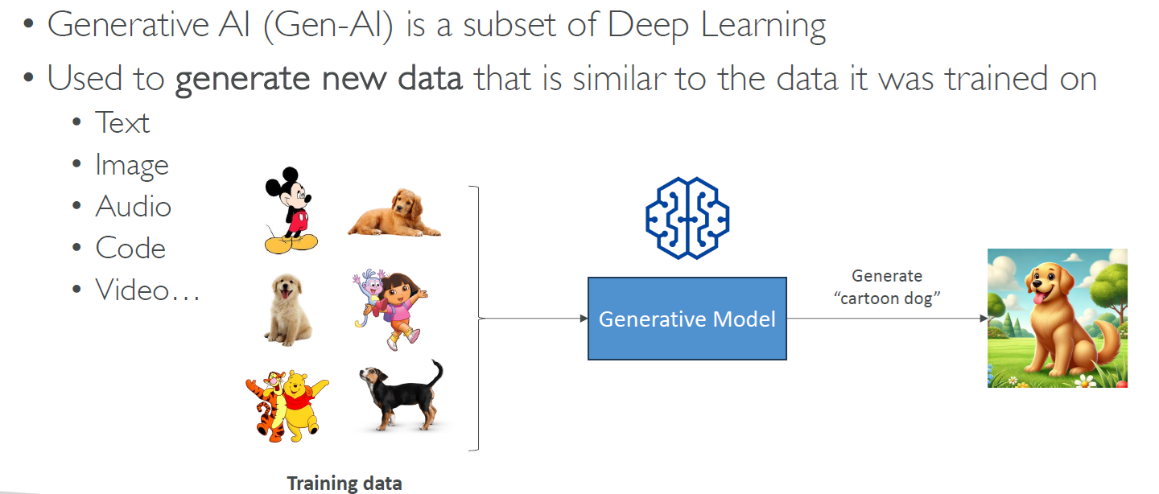
What is Generative AI?

Slide 4
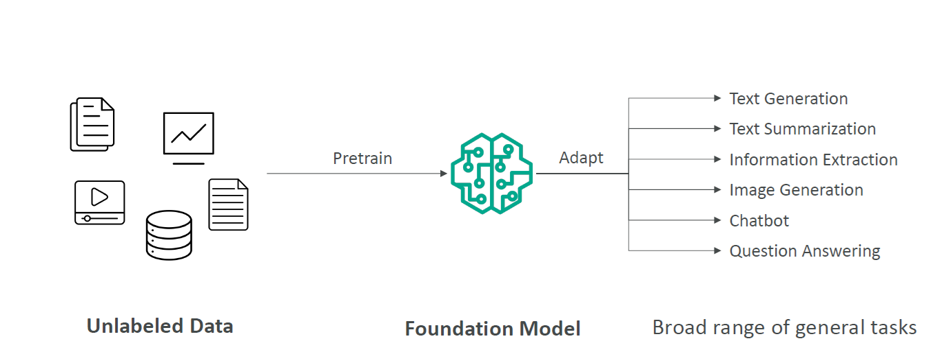
How Generative AI Works?

Slide 5
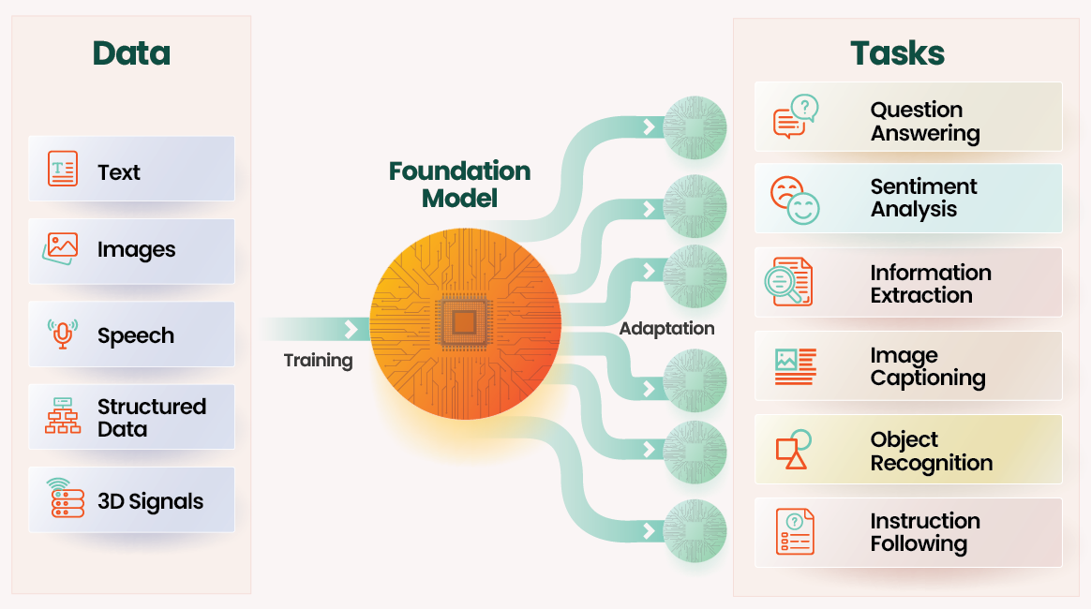
How Generative AI Works?

Slide 6
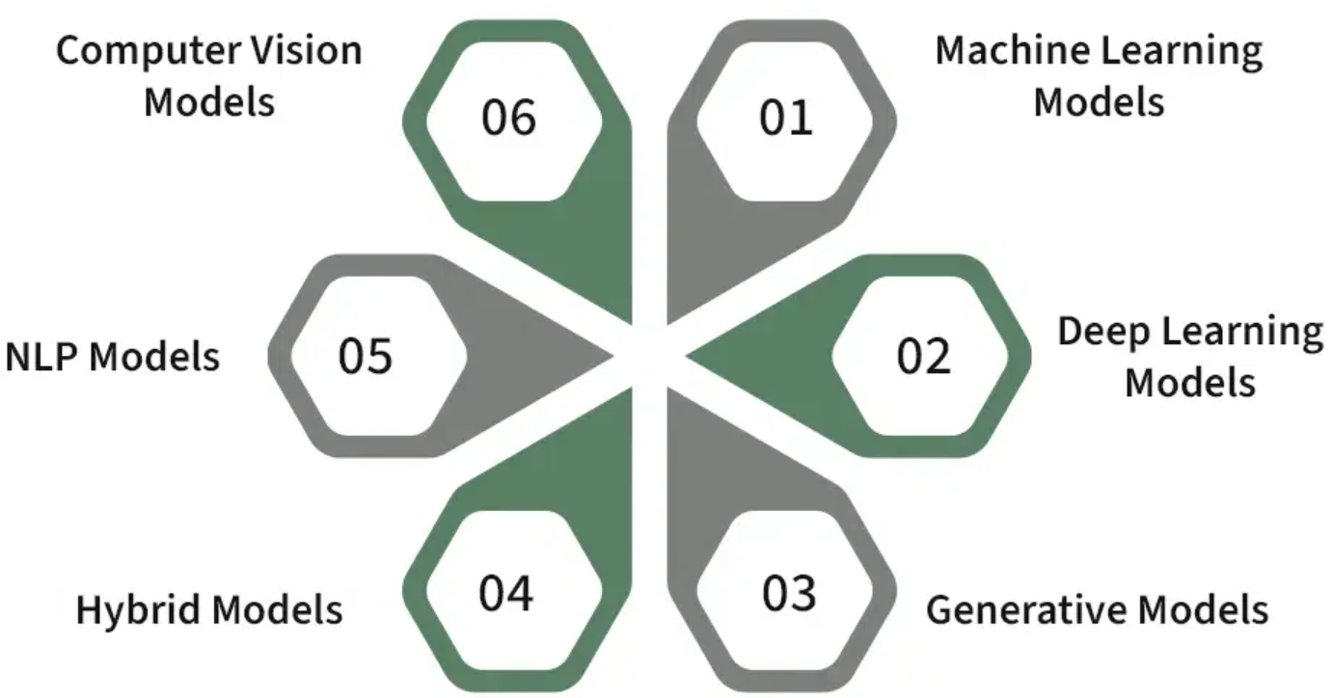
What is a Model in AI?
An AI model is a mathematical system trained on data to recognise patterns and make predictions, classifications, or decisions.
🔑 Key Points:
Learns from data (training process)
Uses input to generate meaningful output
Examples: Spam filter, image classifier, language translator
Core of all machine learning and AI applications
Notes:
🧠 1. AI Model as a Student Learning from Examples
The model is like a student.
It studies from examples (training data).
After learning, it takes tests (new data) and tries to give the right answers (predictions).
💡 Just like a student improves with practice, a model improves with more data and training.

Slide 7
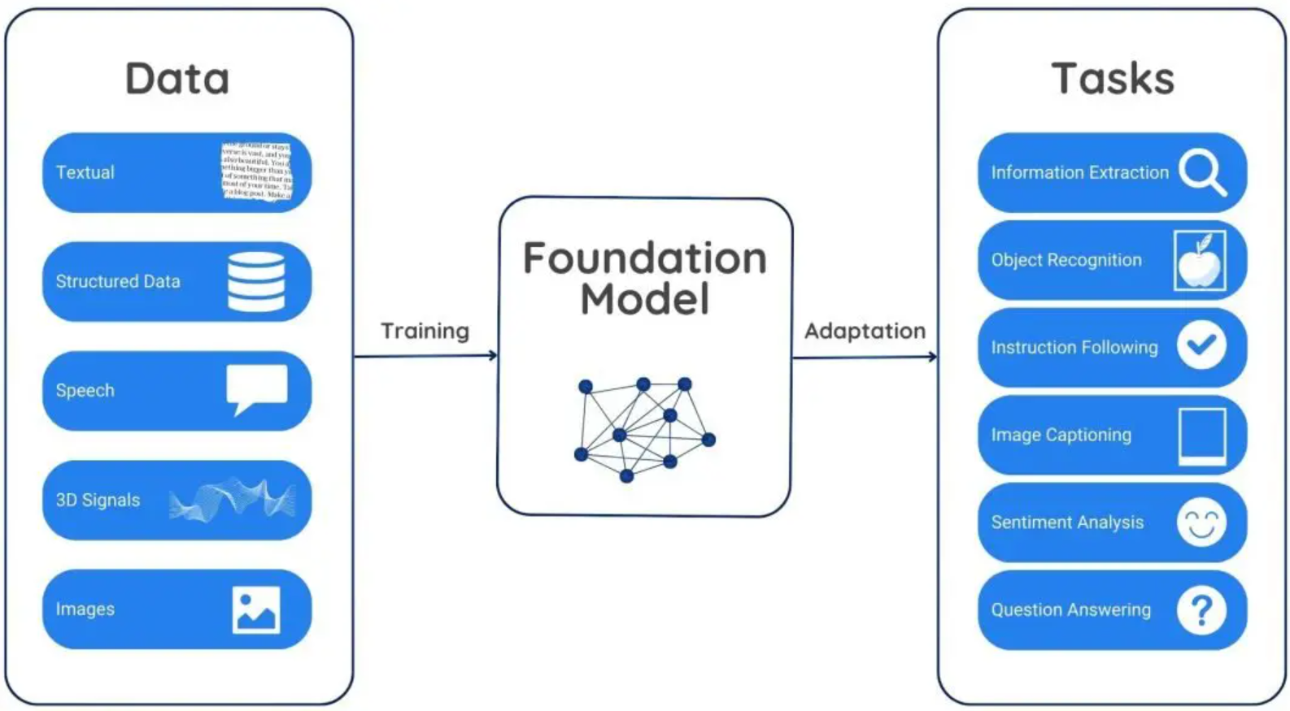
What is a Foundation Model?
A Foundation Model is a large AI model trained on vast and diverse datasets that can be adapted to perform many different tasks — such as text generation, image recognition, translation, and more.
🔑 Key Points:
Pre-trained on massive, general-purpose data
Can be fine-tuned for specific applications
Examples: GPT, BERT, DALL·E
Powers modern AI tools and assistants
Notes:
🧠 1. AI Model as a Student Learning from Examples
The model is like a student.
It studies from examples (training data).
After learning, it takes tests (new data) and tries to give the right answers (predictions).
💡 Just like a student improves with practice, a model improves with more data and training.

Slide 8
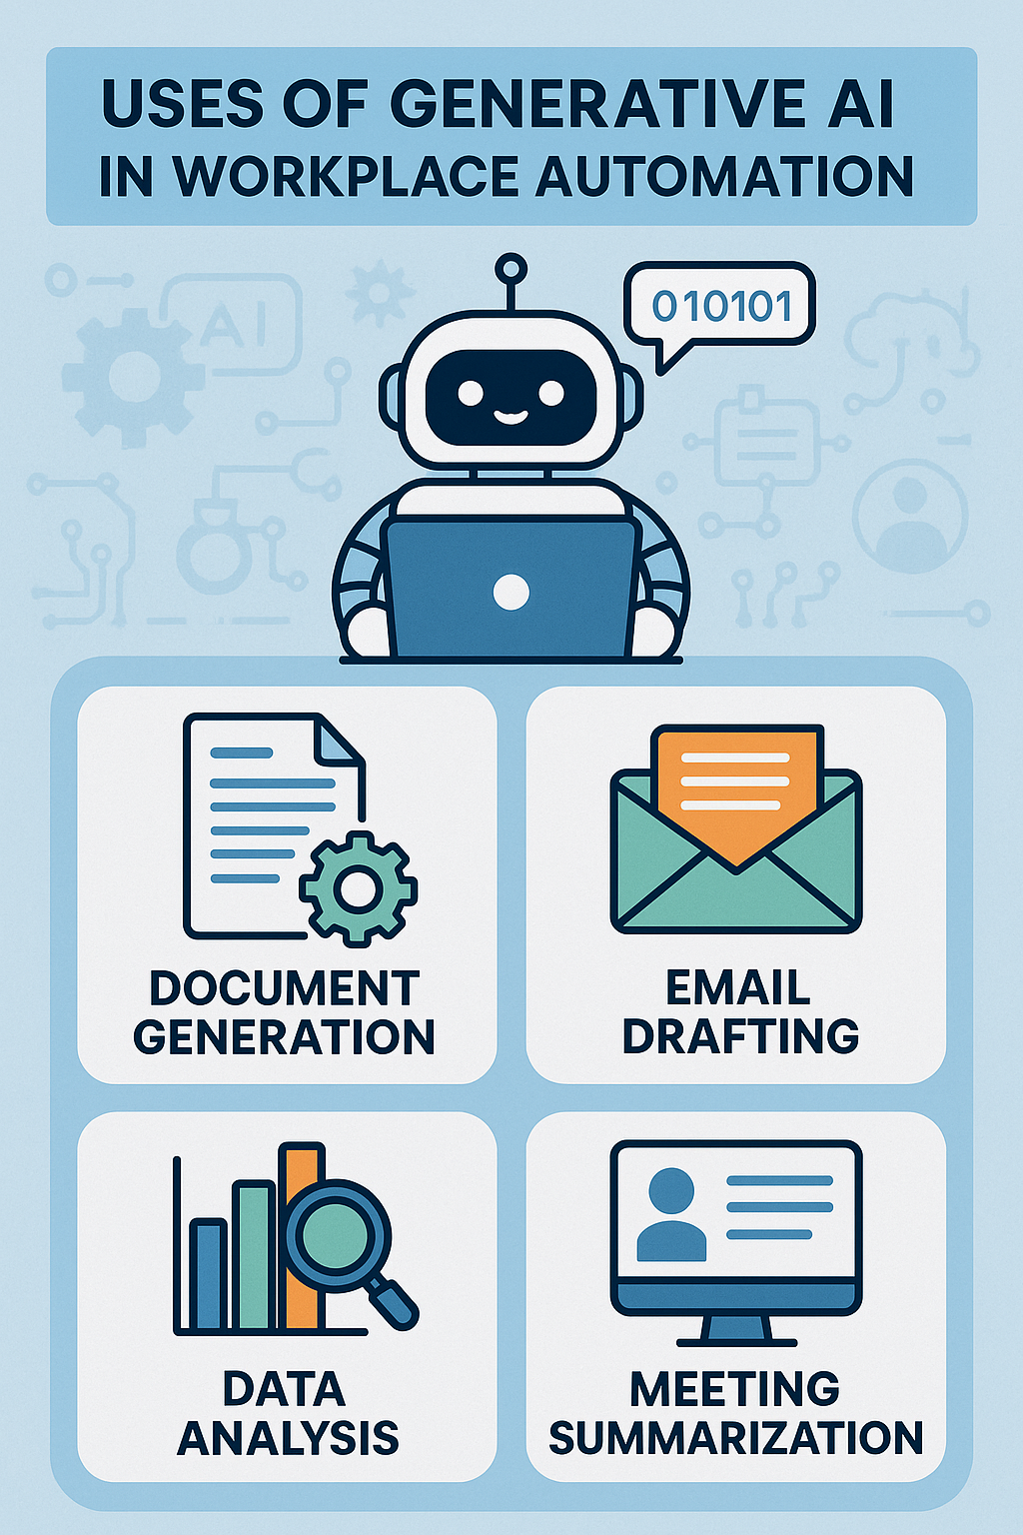
Uses of Generative AI in Workplace Automation
Content creation – auto-generate emails, reports, blogs.
Customer support – AI chatbots for instant responses.
Data analysis – summarise and interpret large datasets.
Code generation – assist in writing and debugging code.
Meeting productivity – transcribe, summarise, and action items.
Design assistance – generate graphics, layouts, and prototypes.
Process automation – streamline repetitive tasks and workflows.
Training and onboarding – create interactive learning content.

Slide 9
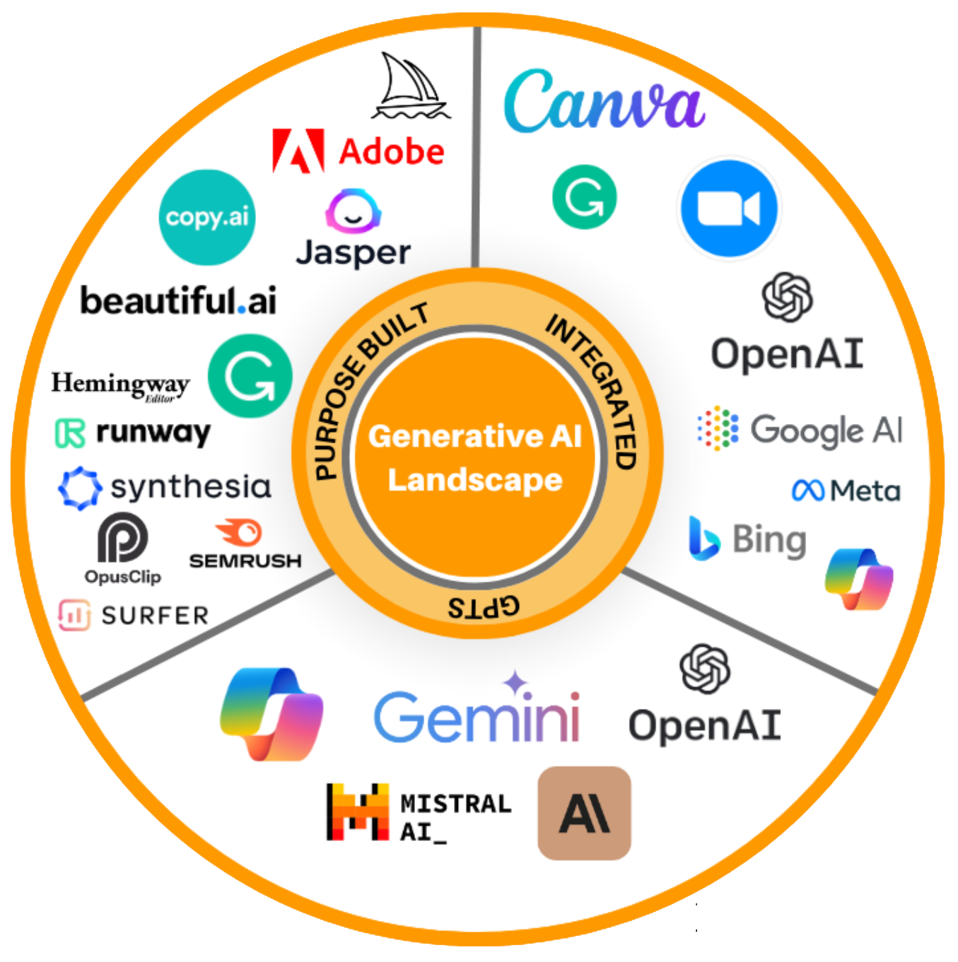
Generative AI Tools

Slide 10
Generative AI Tools
Text-based – Generates written content (e.g., Copilot, ChatGPT)
Image-based – Creates visuals and artwork (e.g., DALL·E, Midjourney)
Audio-based – Produces speech, music, and sound (e.g., ElevenLabs, Soundraw)
Video-based – Generates video content (e.g., Synthesia, Pictory)
Code-based – Assists with programming tasks (e.g., GitHub Copilot, CodeWhisperer)
Multimodal – Combines text, image, and voice (e.g., Gemini, GPT-4 with vision)

Slide 11
Interactive Activity: “AI Around You” – Brainstorm and Quiz
Duration:
5 minutes total
- 3 minutes brainstorming
- 2 minutes quick answers

Slide 12
Interactive Activity: “AI Around You” – Brainstorm and Quiz
Each group or induvial must come up with one real-life example for each category.
Artificial Intelligence
Machine Learning
Deep Learning
Generative AI
3 minutes brainstorming

Slide 13
Interactive Activity: “AI Around You” – Brainstorm and Quiz
Answers

Slide 14
Recap and Conclusion

Slide 15
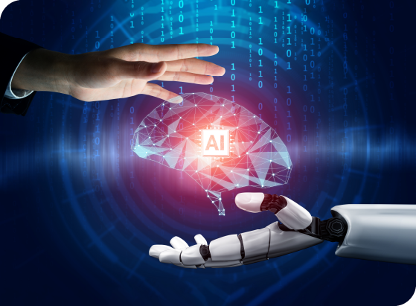
Recap
Basics of AI, Machine Learning, and Generative AI

